Slide 1
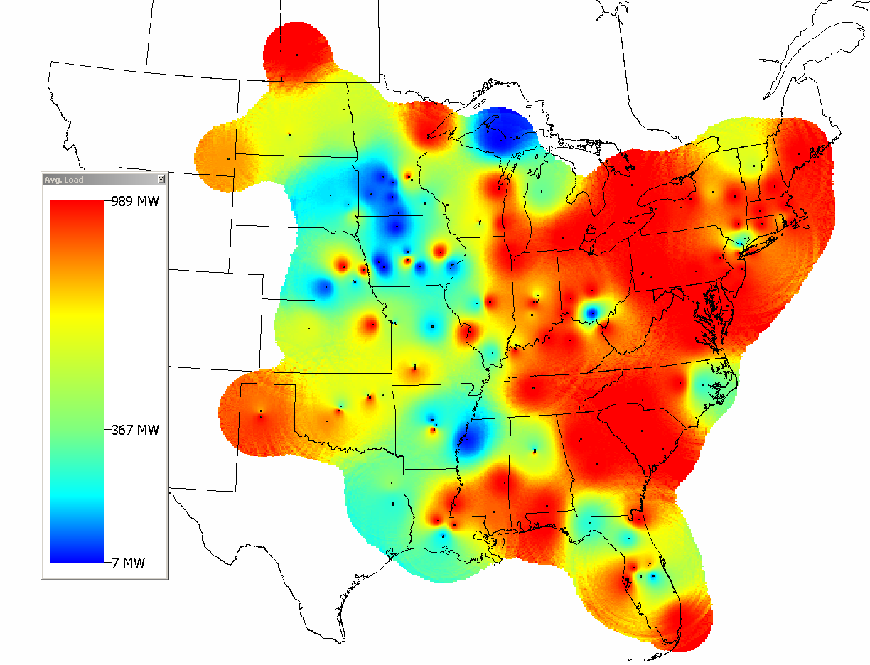
S1 Average Load
S1_Base_C_Hourly_Load-LMPs_Report_9-17-12 Preliminary.xlsx

Slide 2
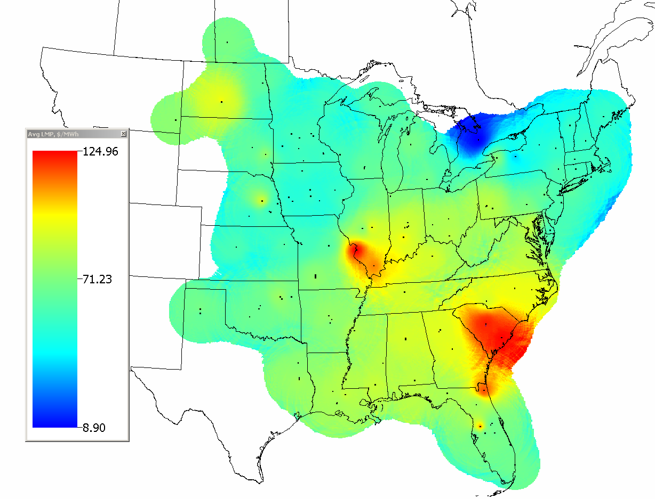
S1 Average LMP
S1_Base_C_Hourly_Load-LMPs_Report_9-17-12 Preliminary.xlsx

